Slide 1
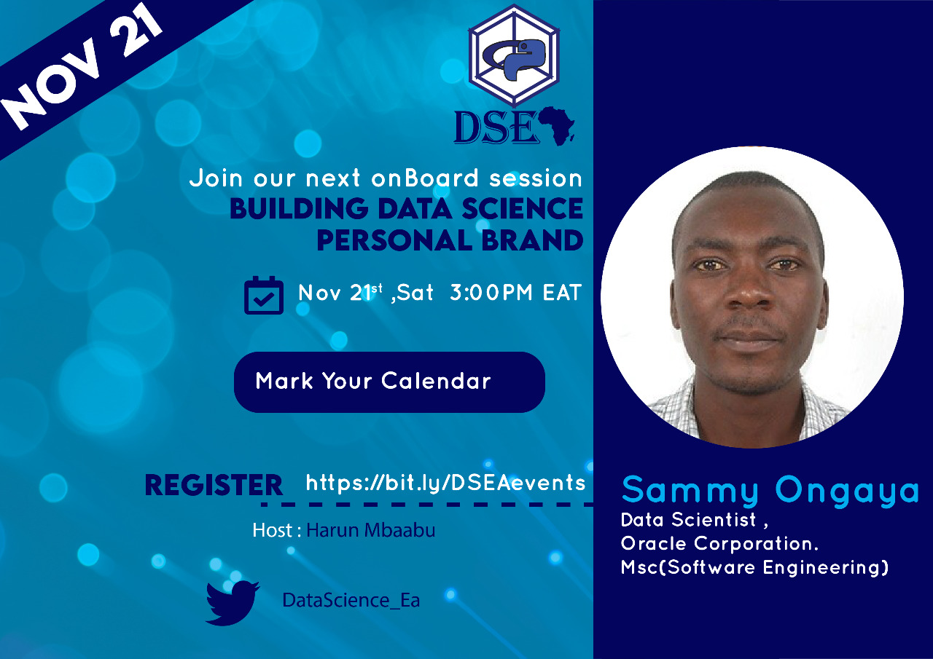

Slide 2
Agenda
History of AI/Machine Learning
Skills
Standing out
Career

Slide 3

History - Driving Factors

Slide 4
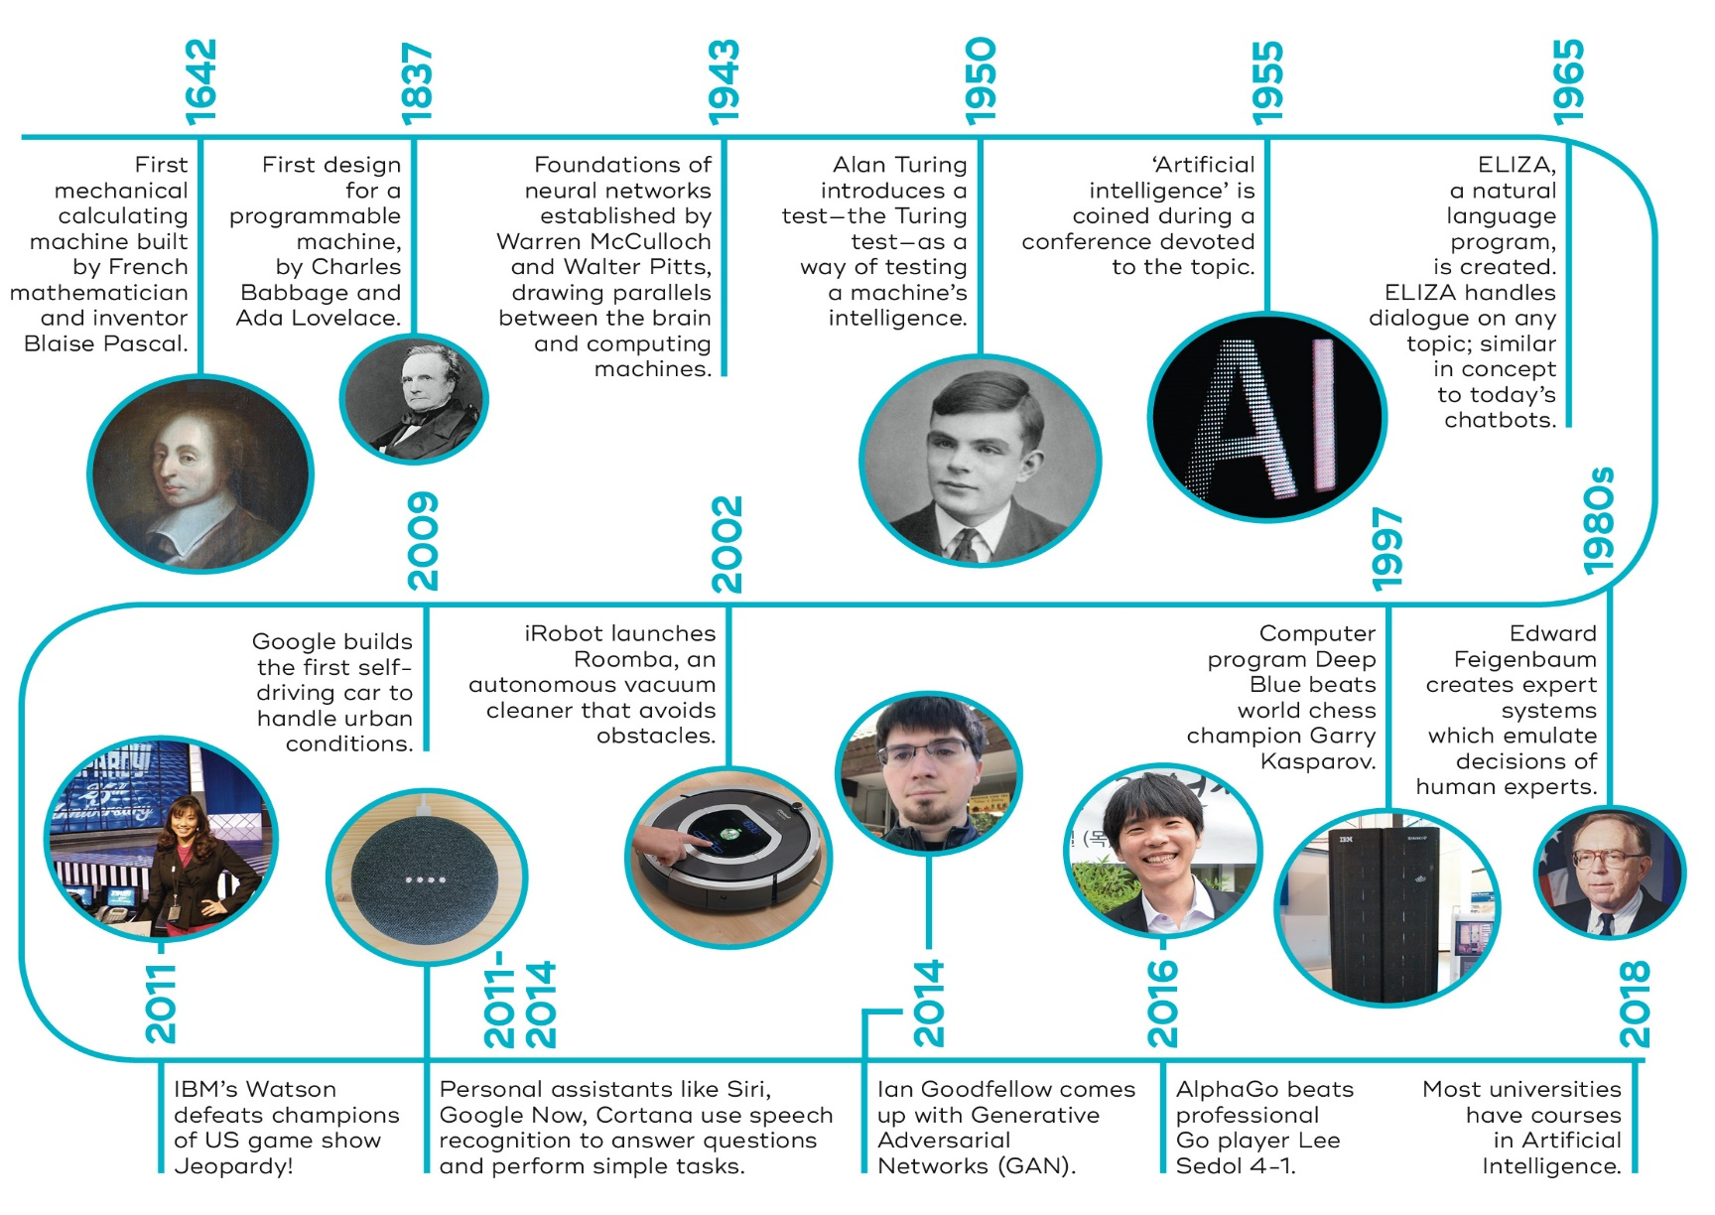
History - AI

Slide 5
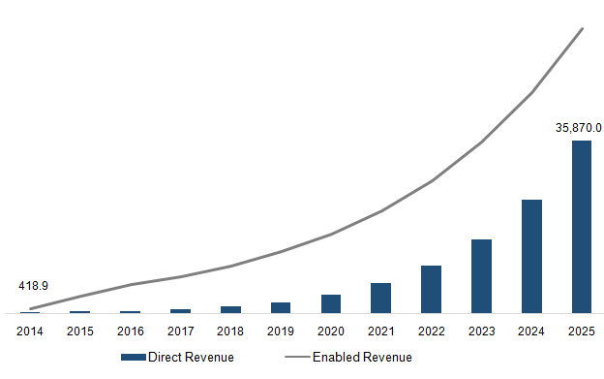
History – Data Science Market

Slide 6
History – Data Science Applications
Technology - recommendation systems, smart devices)
Finance - credit decision, client segmentation, fraud detection
Healthcare – Disease identification & diagnosis, drug discovery, automation of routine tasks e.g. X-rays, CT scans, data entry
Agriculture - Weather prediction, robot harvesters, crop monitoring
Transport - Traffic analysis, autonomous vehicle

Slide 7
SKILLS

Slide 8
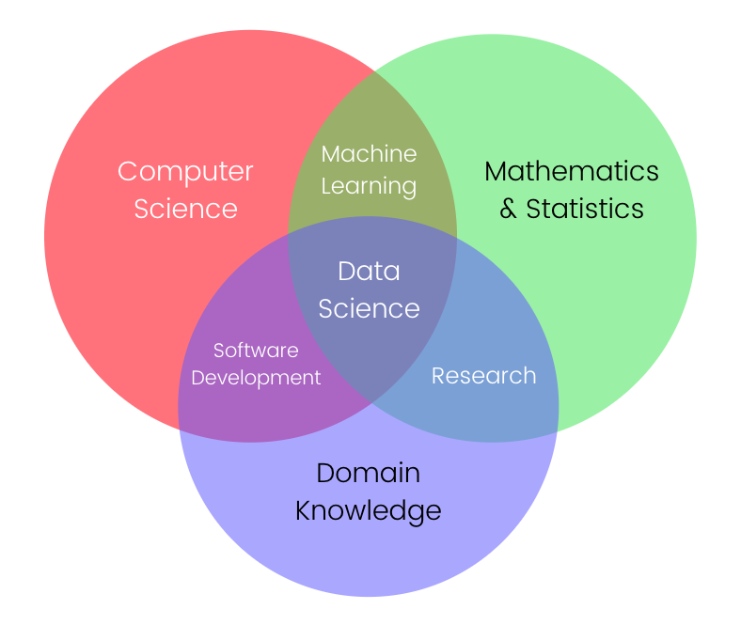
Skills

Slide 9
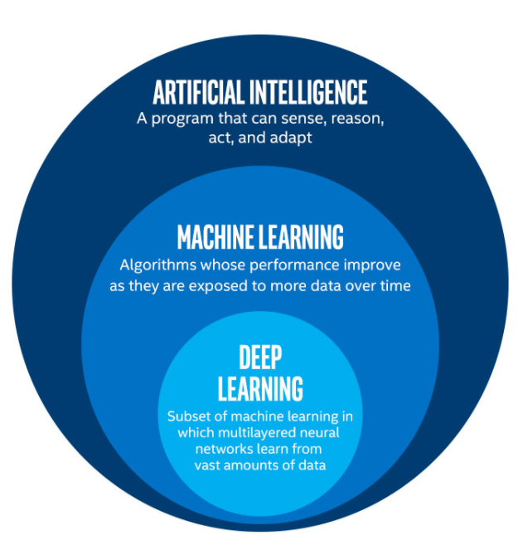
Skills

Slide 10
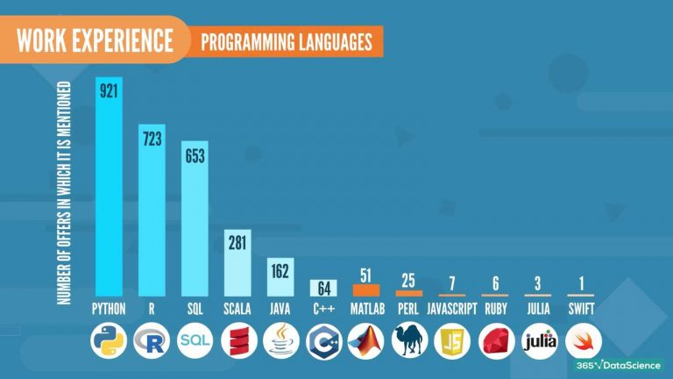
Skills – Programming Languages

Slide 11
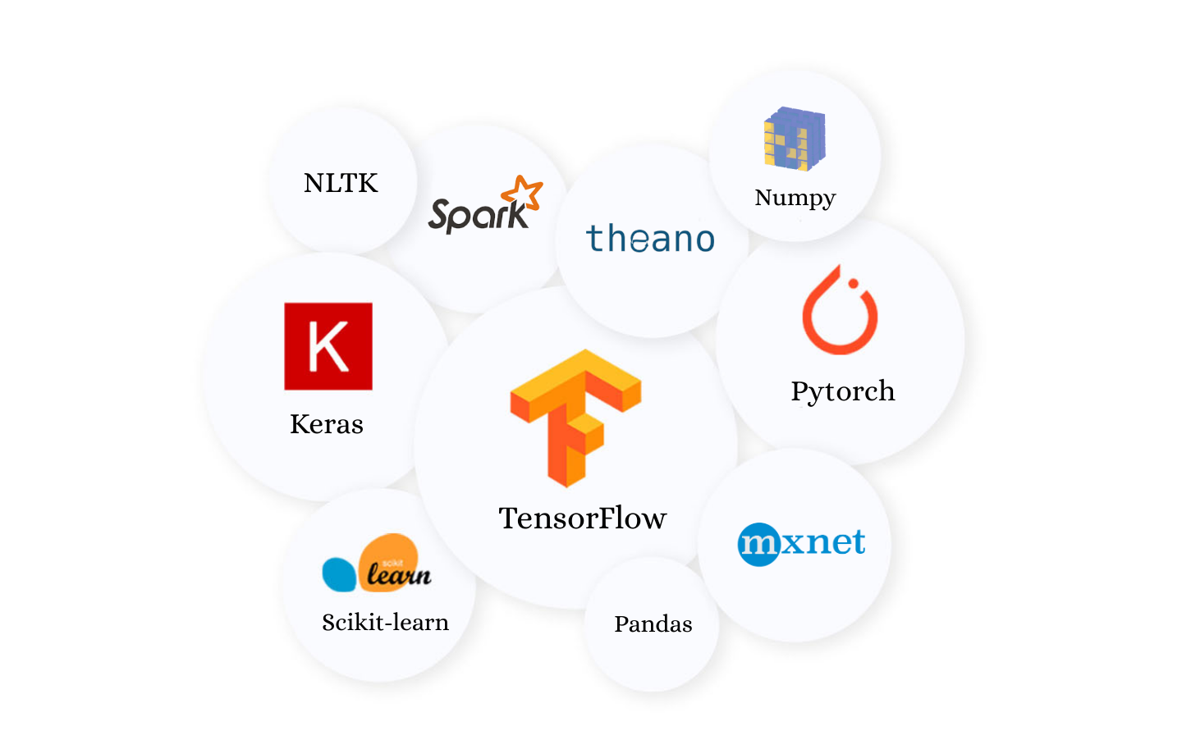
Skills – Frameworks (just few)

Slide 12

Skills – Cloud

Slide 14
Upskilling

Slide 15
Education
“Requires time & money investment”
Formal Education
-Data Science
-Computer Science
-Statistics & Math
-Engineering
-Other relevant disciplines
Bootcamps

Slide 16
Skills – Certifications & Courses
“Requires time & money investment”
Certifications
-Cloudera Certified Professional (CCP) Data Engineer
-Google Professional Data Engineer Certification
-Oracle Cloud Platform Enterprise Analytics
-IBM Data Science Professional Certificate
-Microsoft Certified: Azure Data Scientist Associate
-SAS Certified AI & Machine Learning Professional
-AWS Certified Machine Learning Specialty
-SAS Certified Data Scientist
Online Courses:
-Coursera
-Udacity
-edX

Slide 17
Standing Out
Have Projects portfolio (Build End-to-End solutions)
Leverage GitHub
Knowledge Sharing – blog, video, teaching, research paper publications, webinars
Networking – LinkedIn, Meetups
Data Science / AI/ML Hackathons
Online competitions – Zindi, kaggle ….

Slide 18
Data Science Roles
Data Scientist
Machine Learning Engineer
Machine Learning Scientist
Data Engineer
Data Architect
Statistician
Big Data Engineer
Data Analytics Engineer
Et cetera

Slide 19
Data Science Job Market
Specialize in one area (T-shaped principle)
Have breadth of other areas (T-shaped principle)
Select the industry you’re comfortable working in
Choose your jobs carefully – Have clarity of the JD
Evolve with the industry – Keep learning
Make an impact by solving important problems

Slide 20
Thank You

